Slide 1
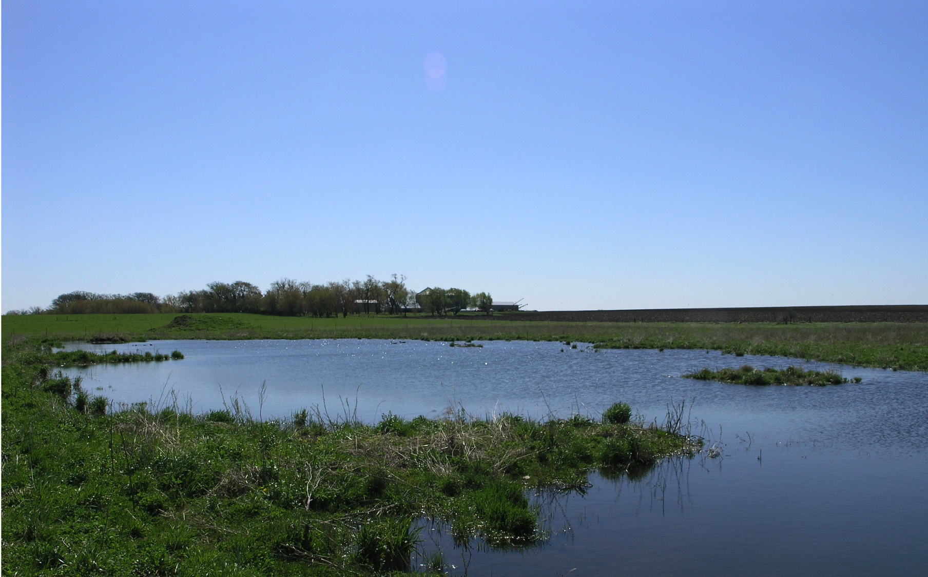
Howard SCWD
Turkey River Watershed
Neil Shaffer & Chad Gilles

Slide 2
Preview
- Commissioners & Staff
- Watershed Projects
- Howard County TRW

Slide 3
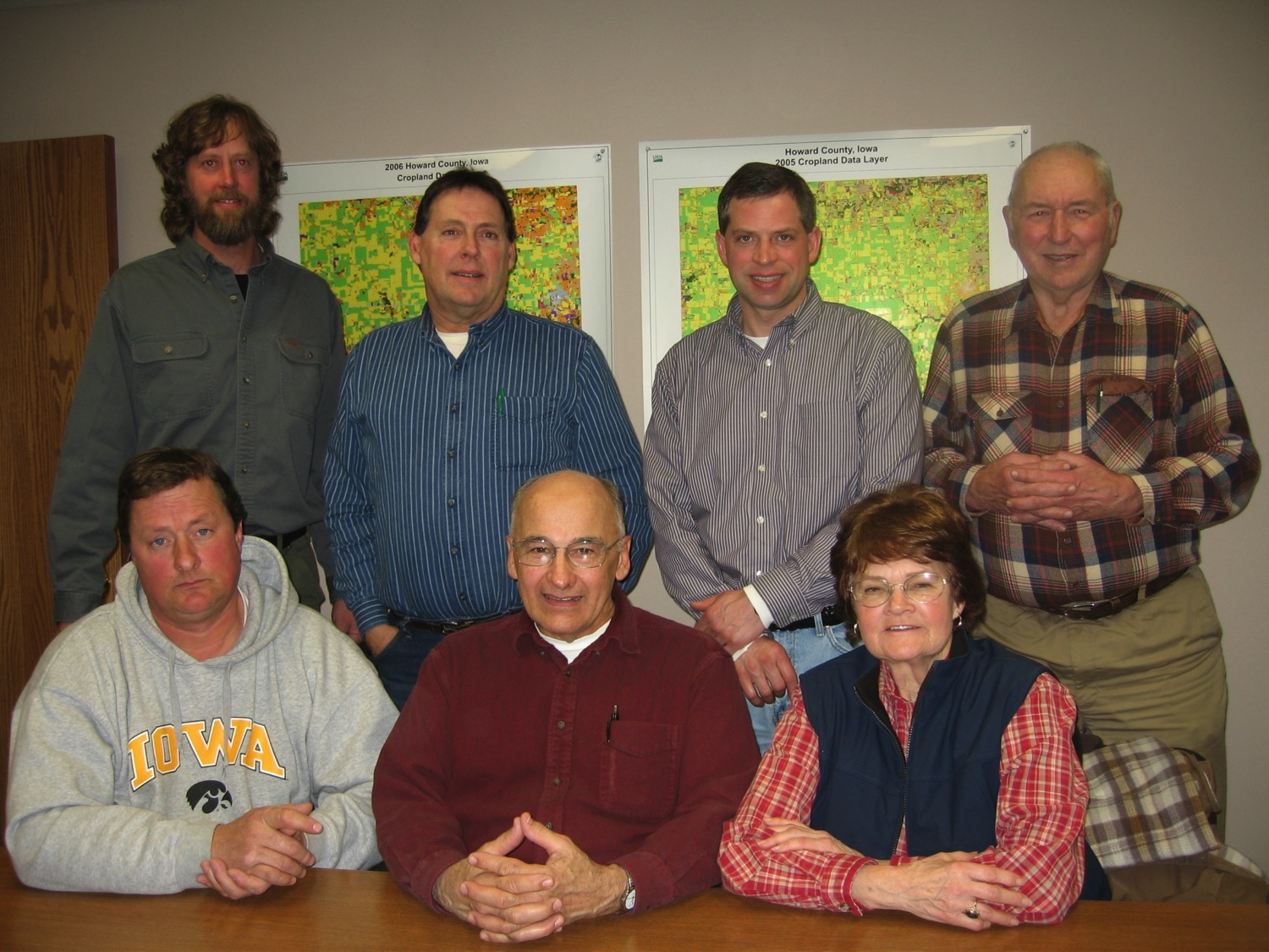
Commissioners
Mike Natvig
Rex
Kleckner
Mike Lewis
Bart Wilson
Glen
Pietan
Harlan
Hickle
Irene
Lund

Slide 4
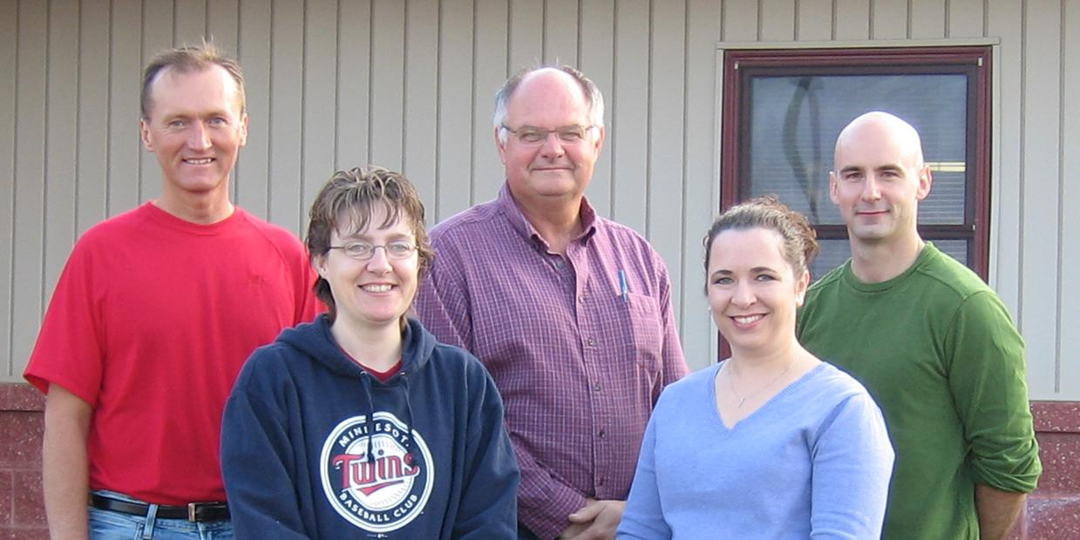
Staff
Neil
Shaffer
Kurt
Hoeft
Chad
Gilles
Shereen
Ries
Shannon
Hurd
* Not Pictured: Beth Rachut

Slide 11
Questions?

