Slide 1
Clayton County Watershed Projects Update
Turkey River Watershed Alliance
January 31, 2013

Slide 2
Objective for the Next 10 Minutes
Past
Update the Turkey River Watershed Management Authority on Previous Water Quality Improvement Efforts within Clayton County
Present
Review Ongoing Efforts in the Silver Creek Watershed
Future
Identify Clayton Soil & Water Conservation District Watershed Efforts Beyond 2013

Slide 3
Clayton County Project History
Big Spring Demonstration Project
North Cedar Creek
Buck Creek
Northeast Iowa Demonstration Project
Ensign Creek
Sny Magill
Hickory Creek (Allamakee)
Ensign Hollow II (Ensign & Upper Hewett)
Upper Maquoketa (Fayette)
Bloody Run
Mink Creek (Fayette)
Miner’s Creek
Silver Creek
1986 – 1992
1988 – 1995
1990 – 1995
1991 – 1999
1991 – 1994
1992 – 1999
1997 – 2001
1999 – 2003
2000 – 2005
2002 – 2007
2003 – 2008
2008 – 2011
2007 -

Slide 4
Location of Past Projects

Slide 5
Past Focus = Protect High Quality Waters Spring Fed, Cold Water Trout Streams

Slide 6
What Happens During a Project? Example from Big Spring
Before
After

Slide 7
Big Spring Example
Project Coordinator Visits our Farm
Problem: Nitrates, Herbicides Detected in Groundwater
Asked to Reduce Soil Losses
Installed Contour Stripcropping System
Cost Share Incentives Available
Helped Refine Fertilizer Applications
Soil Sampling Identified High P2O5 & K20 levels
Eliminated Nitrogen Applications for Corn Following Alfalfa
Reduced Nitrogen Applications where Manure was Applied

Slide 8
Information Marketing

Slide 9
Bugenhagen Subbasin, Big Spring

Slide 10
Current Project = Silver Creek

Slide 11
Soil Loss and Sediment Delivery 90% of 18,000 Acre Watershed is Cropped
Row Crops
Long, Steep Slopes

Slide 12
Less than 11% of the Stream had a Buffer > 60’ Severely Eroding Streambanks

Slide 13
Sinkhole Protection > 60 Sinkholes in Watershed, Some In-Stream

Slide 14
Livestock Access Cattle Grazed 41% of the Stream Length in 2006

Slide 15
Impairment Process Confirms Observations
Agency Emphasis Shifts from High Quality Resources to Impaired Waters
Silver Creek “Impaired” for Aquatic Life since 2002
Stressor Identification Monitoring in 2007
Elevated Un-Ionized Ammonia
Silt Accumulation and Sedimentation of Substrates
Low Dissolved Oxygen
Loss of Flow to In-Stream Sinkholes
Total Maximum Daily Load (TMDL) Written in 2009
Sediment
Soil Erosion from Cropland & Streambanks
Ammonia
Livestock Access to the Stream
Magnified by pH and Temperature

Slide 16
Silver Creek Project Objectives
Promote Stream Corridor and Sinkhole Protection and Install Buffer Practices
Target Practices to Reduce Sediment Delivery by at least 700 Tons Annually
Increase Public Understanding of Water Quality Issues
Continually Evaluate Progress and Renew Priorities for Improvement

Slide 17
Landowner Actions
Filter Strips
Livestock Exclusion

Slide 18
Landowner Actions
Upland Treatment
No-Till

Slide 19
Landowner Actions
Grade Stabilization Structures
Streambank Protection

Slide 20
Silver Creek Watershed Practices Installed Since 2007
65.3 Acres New & Re-enrolled Buffers
190,440’ Terraces
4 Grade Stabilization Structures
60 Acres Pasture Improvement
450’ Streambank Protection
1 Animal Waste Management System
12,465’ Grassed Waterways

Slide 21
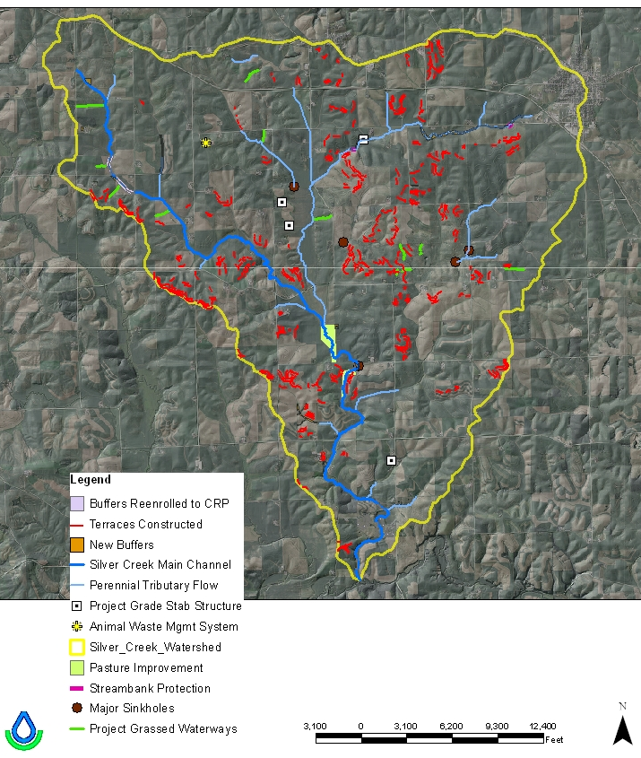

Slide 22
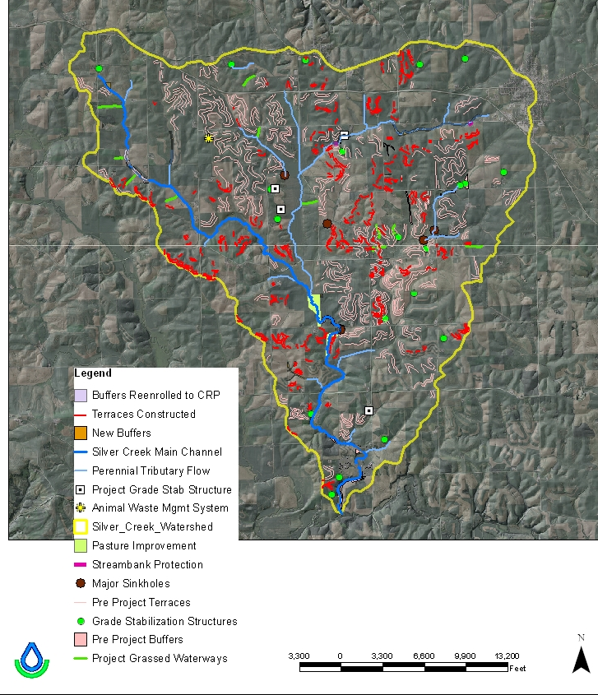

Slide 23
Common Project Themes
Improve Water Quality
Reduce Sediment and Nutrient Delivery
Increased Outreach to Landowners
Staff Specific to Watershed
Reach Out to Non-Traditional Cooperators
Accelerate the Adoption of Practices
Additional Financial Resource for District Programs
Otherwise, 10 Year Wait for Cost Share for Fall Terrace List in Clayton County

Slide 24
Future Efforts
Continue Silver Creek
Extended to 2015
Lindsey & Honey Creek
Led by Delaware SWCD
Mississippi River Basin Initiative
Pine & Steeles Branch
Cooperative Effort led by the Delaware SWCD
Development Grant in 2012
Includes John Deere Lake at Camp Klaus, Pine Creek and Steele’s Branch Creek Watersheds

Slide 25
Potential Pilot Projects
Upper Roberts Creek
Howard Creek

Slide 26
“Relationships Before Issues and Tasks”
Most Watershed Projects Last 3 to 5 Years
Most Farm Operations = 30 or More Years
Foster a Long Term Relationship
Many Watershed Project Cooperators are First Time Participants
A Good Experience Keeps Them Coming
Extend Conservation Benefits Well Beyond a Project’s Tenure

